Slide 1
Teacher educators matter
Educators

Slide 2
Outline
A new species in Europe?
Teacher educators matter?
A key profession without policy attention?
European actions
Key messages
A Dutch perspective
European exchange

Slide 3
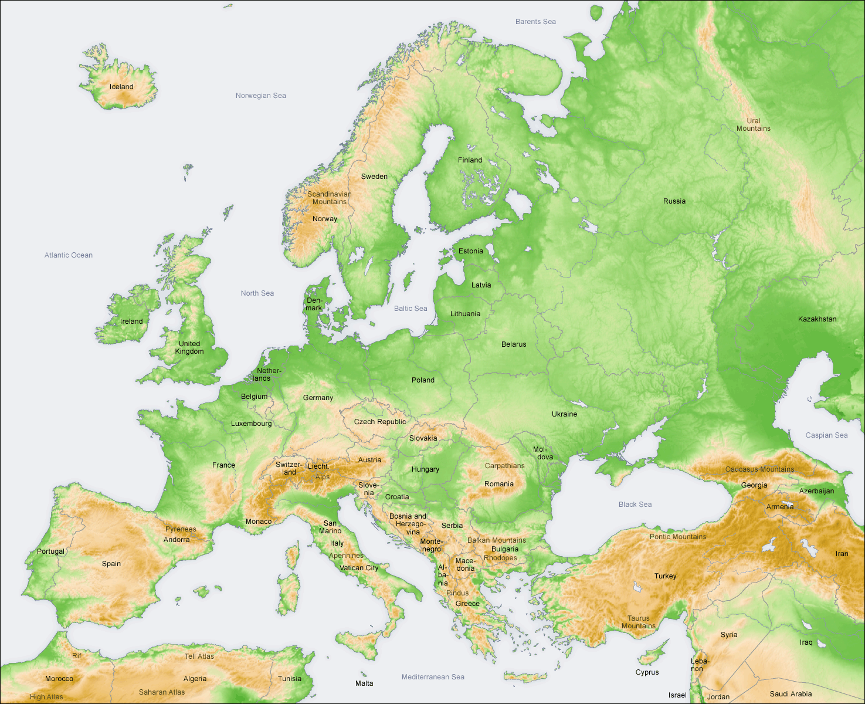
A new species in Europe?
1600 members
2000 members
200/300 members
400 members

Slide 4
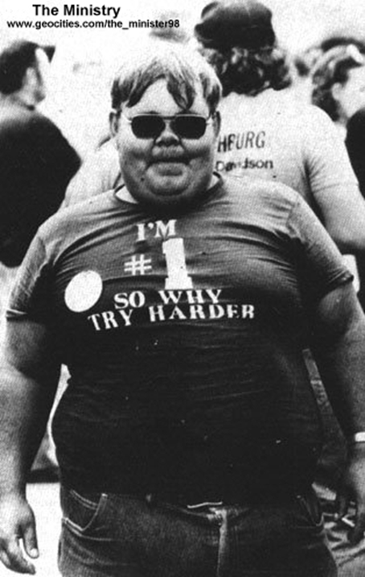
Teacher educators matter
Teachers are the most crucial factor in the learning of pupils …
Teacher educators are the most crucial factor in the learning of (student) teachers ?
National and European policy attention for teacher quality …
What about policy attention for the quality of teacher educators?

Slide 5
Existing policies in member states
Analysis of European policy documents and questionnaire for policy makers in 13 member states:
Very limited policy attention
National regulations focus on ‘teachers in higher education’ and on qualification levels.
Little research on teacher educators
Low level of professional organisation
Key roles for heads of faculties, limited role for professional groups
(Snoek, Swennen, vd Klink, 2011)

Slide 6


Slide 7

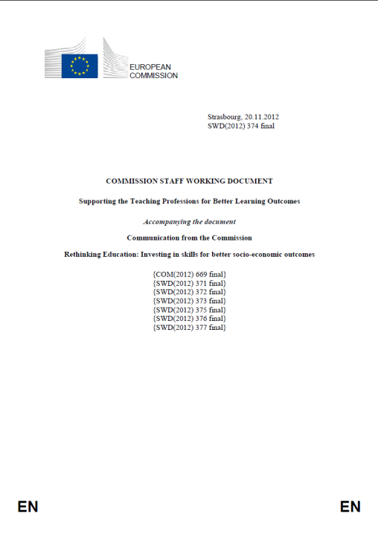

European actions
Peer learning activity Reykjavik - June 2010
Peer learning conference Brussels – March 2012
Eur Commission staff document: Supporting the teaching professions – Nov 2012
EU presidency conference Dublin – Febr 2013
Handbook/Policy suggestions ‘Supporting teacher educators’: Oct 2013

Slide 8

Key massages: Who are teors?
Those that actively faciltate the (formal) learning of student teachers and teachers.
Multiple identities:
Teachers
Teachers in higher education
Teachers of teachers
Modelling teaching behavior to their students
‘Teach as you preach’

Slide 9

Key messages: Quality and competences
A focus on teacher educator quality and competences
As a frame of Reference for selection, professional development and assessment of Teacher Educators
To support and strengthen the professional awareness and identity of teachers educators

Slide 10

Key messages: LLL of TEors
No intitial education to become a teacher educator exists
Induction is a crucial phase to change from teacher to teacher educator
- from knowledge on teaching and learning of pupils to knowledge on how to become a teacher (adult learning, workplace learning, …)
Need for systematic life long learning opportunities and activities for teacher educators
Need for ownership by the profession

Slide 11

Key messages: Research on TEors
Developing knowledge: constant dialogue between theory, practice and research
Research grants and studies
  On teaching and learning of teachers
  On teacher educators
Selfstudy by teacher educators
Using knowledge
Through publications of research outcomes
Through developing knowledge bases on educating
teachers

Slide 12

Key messages: professional communities
A professional identity presupposes a collective awareness of that professional identity.
Professional communities can strengthen collective understanding and can act as a voice representing the teaching profession.
Associations, regulatory bodies, unions, … focusing on the identity and quality of its members and their work
  Framework for professional quality,
  Quality assurance (e.g. through a register)
  Developing and sharing knowledge through research, exchange, …
  Courses, workshops
  Contribution to national
  policies
Support from national/regional
governments?

Slide 13

Key messages: social dialogue
Stakeholders: national/regional authorities or agencies, heads of faculties, teacher educators, student teachers, teaching profession, school authorities
Roles and responsibilities for each stakeholder
Quality and standards as core of the professional identity need to be owned by the profession itself.

Slide 14

A dutch perspective
Who are? | University and schoolbased Teors
Quality? | Professional standard and register by VELON
LLL? | ??? Knowledge base for TEors, register, conferences
Research | Knowledge base, several projects, PhD theses, …
Prof comm | VELON, 1600 members
Social dial. | Dialogue with Ministry, faculty leaders (separately)

Slide 15
A dutch perspective
The quality of teacher educators
1993: Invitation to the Dutch Association for teacher educators (with financial support)
1994: Professional standard/competences
1995: Professional register with peer assessment procedure
2006: Including school based teacher educators
2008: Towards a register for all teacher educators
2010: Development of a knowledge base for teacher educators

Slide 16
A dutch perspective
Roles & responsibilities
Ministry of Education
  Minimum qualifications for teacher educators
  Supporting the development of the profession
  Performance agreements with institutions

Slide 17
A dutch perspective
Roles & responsibilities
Employers/heads of TEI
  Selecting teacher educators
  Guarantee minimum quality of teacher educators
  Support and facilitate professional development of TEors

Slide 18

A dutch perspective
Roles & responsibilities
Dutch Association of teacher educators
  Defining professional standards for teacher educators
  Maintaining a professional register
  Assessing individual TEors (developmental)
  Support professional development through a knowledge base, conferences, publications

Slide 19
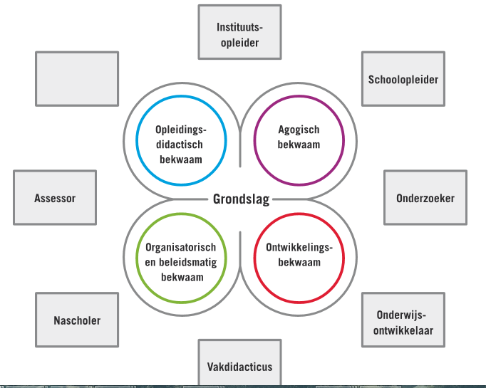
University
based TEor
School
based TEor
Didactical and
methodological
competence
Pedagogical
competence
Foundation
Researcher
Organisational
and policy
competence
Personal
development
competence
In-service
based TEor
Curriculum
developer
Fach Didakter
PCK specialist

Slide 20

Knowledge base
The TEor profession
The pedagogy of TE
Learning and learners
Teaching and mentoring
PCK/ Fach Didaktik
Types of TE
Context of TE
Organisational issues
Curriculum and assessment
Research in TE

Slide 21

A dutch perspective
The registration procedure
Volutary (400 teacher educators are registered)
Focus on development and assessment
  Portfolio
  Self-analysis
  Development plan
Assessment by peer-assessors
After four years: renewal of the registration/assessment
No formal status or recognition

Slide 22

Finally
Connecting TEors through Europe?
BAK
VELON
VELOV
Association of Hungarian Teacher Educators
…
Peer learning through exchange of good practices

Slide 23
Thank you

