Slide 1

International Conference
Education and Training for European Teachers:
Competence Models, Curricular Objectives and Harmonising Theory and Practice
Organised by
Project nexus – Concepts and Good Practice in Higher Education
January 20th – 21st, 2014
Sanaa-Building
Zollverein World Heritage Site
Essen
Workshop 3
Training the Educators and Trainers? Strengthening Competences and Supporting the Professional Development of Teachers and Teacher Educators
Teacher educators and professional development
Jón Torfi Jónasson,
School of Education, University of Iceland jtj@hi.is

Slide 2
Workshop 3
The points of departure in the presentation, defined by the organisers
Although many European states pursue policies in support of teachers or school leaders, they often lack specific policies or provision concerning teacher educators' recruitment and selection, their qualifications, or their continuing professional development. Furthermore, in many states there is currently little professional contact between teacher educators based in schools and those based at universities or elsewhere. Accordingly, we will inter alia discuss the following questions in this workshop:
Who are our teacher educators?
How do they achieve the education and qualifications they need to do their job?
How do we assure the quality of their work?
Who is responsible for making sure that this happens?

Slide 3
Teacher educators and professional development
The points of departure in the presentation
Three grand challenges for teacher education
We should concern ourselves with the aims of education, what they are and how they may change. Only thus can we determine who should have the task of educating our teachers and what is their task or mission.
We must move the focus of the debate and the system of teacher education, from pre-service to in-service, where the latter is gradually allowed to subsume the former.
The culture of deliberate, informed and creative development must characterise our schools and thus our endeavours.

Slide 4
The pupils; those that educate them and those that educate them
The task of education
centring around the pupils
The teachers and their education and development
The teacher educators, their agenda, homogeneity, identity, education, credentialing and development.

Slide 5
The pupils; those that educate them and those that educate them
The task of education
centring around the pupils
The teachers and their education and development
The teacher educators, their agenda, homogeneity, identity, education, credentialing and development.

Slide 6
Teacher educators and professional development
The points of departure in the presentation
The task and some questions
The actors and the task
The system

Slide 7
Teacher educators and professional development
The points of departure in the presentation
The task and some questions

Slide 8
The task and some questions
The task is to educate teachers and assist, stimulate and guide them in their professional development throughout their career
There are several issues implicated. How does the aim, content and operation of education change during the career of a teacher, how does his or her career take off in different directions (within the educational setting) and what should be the “division of labour” between the ingredients or content of initial training on the one hand and professional development on the other? How are these issues discussed within the education edifice? Then, who should be responsible for the different phases of teacher development and on what structural and financial basis should it rest? Is the distinction commonly made between initial education and professional development possibly becoming both obsolete and pernicious?

Slide 9
The timeline of teacher education and education

Slide 10
A schematic diagram indicating the way many people think (implicitly) about education, accepting a relatively sensible description for the 1950’s
It is suggested here that a much more appropriate description or conceptual framework would be (note we are hinting at 5 x 20 year periods):

Slide 11
The timeline of teaching and teacher education

Slide 12
The actors and the task
Teachers
Teaching is a profession which must be empowered by a purpose and competence, which in unison create its identity. Teachers must also be encouraged to act, in particular to continuously develop their practice.
This is, however, more complicated than it appears at first sight; the purpose of education needs to be seriously and urgently reconsidered, the modern competences should probably be very different from what tradition has defined, and there are serious interest and identity conflicts within the field.

Slide 13
The actors and the task
Teacher Education. Ingredients, i.e. the tasks of the teacher educators
Education of teachers should be characterised by:
Spectrum of competencies
The spectrum of competencies the teaching force should have is vast and more multifaceted than is often assumed. It is also changing fast and must therefore be constantly and critically re-evaluated. Thus the spectrum of teacher educators is also wide, again along a number of dimensions.

Slide 14
(Educational?) Research orientation
Educational studies, + inclusive school, individualised teaching, motivation,
The content of a teacher education programme
(New) skills
Future orientation
Discipline didactics PCK
Teaching in schools
Aims of education
School based education Professional development
New disciplines, new tasks
The discipline as a school subject
Technology and its implications
The discipline
Schools as institutions, professionalism
General didactics

Slide 15
The actors and the task
Teacher Education. Ingredients, i.e. the tasks of the teacher educators
Education of teachers should be characterised by:
*Unity of purpose rather than either homogeneity or fragmentation
Educating teachers seems to have a unitary aim but is controlled by many and diverging views and vested interests. The fragmentation is along at least three dimensions: level of education in the system (kindergarten through tertiary, to workplace), speciality (e.g. subjects) and there is considerable division of labour within the system. There is also tension, which in some cases can be quite dramatic but depending on the educational level and educational system, often nourished by differing views about what education is for and how it should be conducted.

Slide 16
Deconstructing the aims of education and relating them to, e.g. PISA or the world of work
The aims of education
PISA
For society, world of work, survival, democratic and cultural participation, …
For the individual,
skills, well being, social functioning …
The world of work

Slide 17
Deconstructing the aims of education and relating them to, e.g. PISA or the world of work
The aims of education
PISA
For society, world of work, survival, democratic and cultural participation, …
For the individual,
skills, well being, social functioning …
Education for “a job”

Slide 18
The actors and the task
Teacher Education. Ingredients, i.e. the tasks of the teacher educators
Education of teachers should be characterised by:
Understanding of the school as a social and a cultural institution
The school is a place of learning, enculturation, and at least implicitly with emphasis on socialization. It is equally important to note that the school is an institution controlled by strong external cultural and social forces. Those emanating from the social world in which the young people live are increasingly powerful. Those preparing for a lifelong career within the schools, must come thoroughly to grips with the notions and implications of this. They must understand that, what they are doing as teachers cannot be limited to “teaching an academic subject” and seeing their learners as “just learners” but as people who are already, and are also being prepared to be, an active part of the world around them, now and throughout their lives.

Slide 19
The actors and the task
Teacher Education. Ingredients, i.e. the tasks of the teacher educators
Education of teachers should be characterised by:
*The culture of change. How it must be nurtured and understood
Among the most important considerations for the education system is the notion and culture of change, - some of which occurs very fast and which should be taken much more seriously than hitherto within the field of education. Dramatic technological developments, with a huge potential impact on teaching, are only one face of this change. The role of education is changing, so are its cultural and social settings, e.g. the ingredients and culture of the labour market, but changes occur also along other dimensions. The ethos, content, tools and operations of education and also the expression of its aims should be changing much faster than is generally accepted; much of the change outside the schools is accelerating at exponential speeds, this includes the students themselves. The culture of change also demands thorough understanding of the enormous resistance to change (often quite legitimate) among important vested interests held by the stakeholders moulding the system.

Slide 20
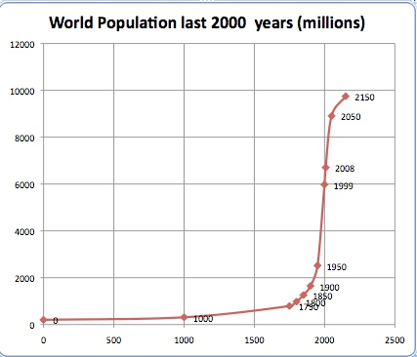
An example of exponential growth

Slide 21
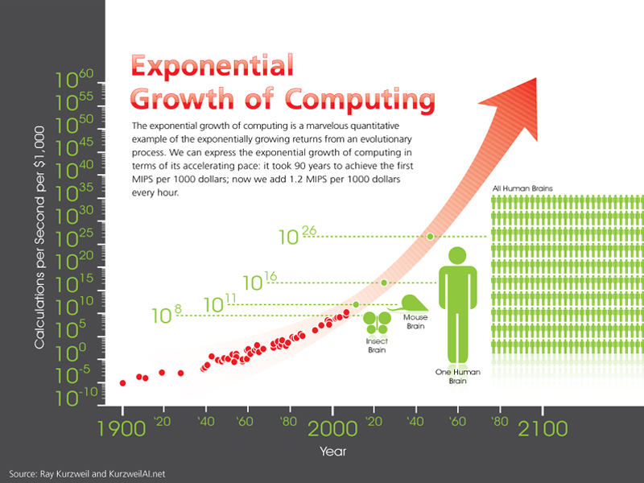
Staðan tekin

Slide 22
Where are we now within education? On balance?
How is the school system addressing the past, the present and the future?

Slide 23
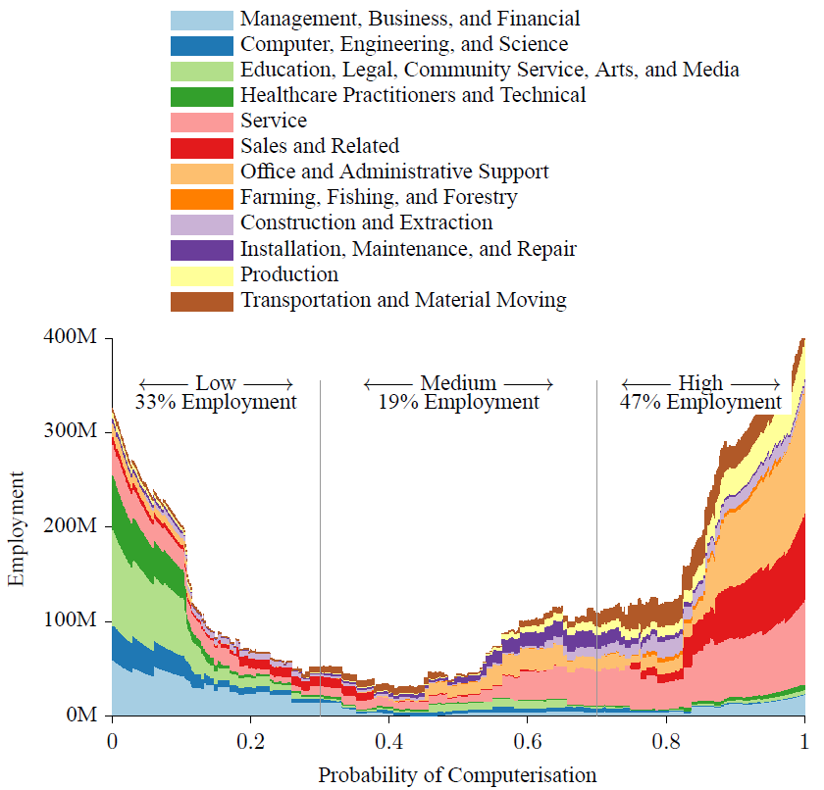
Nearly half of US jobs could be at risk of computerization, in the next two decades, , a study from theOxford Martin Programme on the Impacts of Future Technology suggests.

Slide 24
The actors and the task
Teacher Educators
Who are the teacher educators, and how do we see their different roles?
If it is accepted that teacher education ranges from the first day at pre-service class right up to the end of a career, it becomes important to ask to what extent or in what sense can teacher education be classified as a profession? And how might the views on this issue have changed in recent decades?
And then we proceed: Who are then the teacher educators, where are they placed, what is their primary mission - or their role? What is their primary identity? What is their background vis-à-vis engaging in professional development of teachers? What do they see as the purpose(s) of education?

Slide 25
(Educational?) Research orientation
Educational studies, + inclusive school, individualised teaching, motivation,
(New) skills
Future orientation
School based education
Professional development
Discipline didactics PCK
Teaching in schools
New disciplines, new tasks
The discipline as a school subject
Technology and its implications
The discipline
Schools as institutions, professionalism
General didactics

Slide 26
Specialists in participatory research
Pedagogical experts
Future facilitators
School teachers
Leadership for change from within the schools
Discipline experts, school developers
New specialists
Facilitators of new tasks
Discipline specialists for education
Educational technology experts
Discipline specialists
Change facilitators
Didactic specialists, school developers

Slide 27
The System
Teacher Education
Where and When? Professional development of teachers should be moved to the centre stage – the identity and the role of the teacher educator in this process must be elaborated respecting this new context.
*When? All the time
There are many compelling reasons why the focus of discussing teacher education should be moved from pre-service (plus an induction year) to the teacher’s professional development, which should normally be seen as a part of the development of a learning organization, the school. This does of course not allow neglecting the first part of the professional education.

Slide 28
The System
Teacher Education
Where and When? Professional development of teachers should be moved to the centre stage – the identity and the role of the teacher educator in this process must be elaborated respecting this new context.
What should come first? Purpose as a foundation for identity
Educating a professional is not properly done by adding some professional (pedagogic) studies or considerations towards the end of a university carrier. It should be a part of the programme from the beginning throughout their career. Substantive competence, characterized simultaneously by pedagogical competence is developed along the way as a part of the professional foundation.

Slide 29
(Educational?) Research orientation
Educational studies, + inclusive school, individualised teaching, motivation,
(New) skills
Future orientation
Discipline didactics PCK
Teaching in schools
Aims of education
School based education Professional development
New disciplines, new tasks
The discipline as a school subject
Technology and its implications
The discipline
Schools as institutions, professionalism
General didactics

Slide 30
The System
Teacher Education
Where and When? Professional development of teachers should be moved to the centre stage – the identity and the role of the teacher educator in this process must be elaborated respecting this new context.
There is a serious rift and fragmentation between pre-service and in-service
Are pre-service and in-service professional development totally different in kind; do they belong to different worlds? No, they should be on a continuum. This invites the question to what extent school personnel, mentors and experienced colleagues should be regarded as teacher educators? And vice versa, what should be the role played by traditional academic staff in school and staff development?

Slide 31
Why Professional development should take the central stage
Three arguments may be presented, each one would suffice on its own as an argument for change, but all of them should be included in a holistic framework for change. These are

Slide 36
The System
Institutions of Teacher Education
There are important institutional consequences of the view presented here.
The above discussion brings up issues related to who are the teacher educators and what should be their credentials and the institutional scaffolding – framework or backing for career long professional development. Then what should be the framework for the professional development of teacher educators, what should be the institutional involvement of teacher education institutions, where should the initiatives lie (e.g. for change) and the financial responsibilities for the task(s)?

Slide 37
The System
Institutions of Teacher Education
What should be the background (education) and professional development of teacher educators? And who should play the leading role? The institutes that are responsible for teacher education?
All the issues that have been brought up for teachers should be brought up for teacher educators, inter alia basic credentials and professional development. Should they be credentialed as teacher educators? If so, on the basis of which criteria and competencies should that be done? And who? To what extent should they, or perhaps some of them, be on top of the enormous volume of research on teaching and education but also the literature and discussion about a potential new era in teacher education and the implications of massive research and consultation within that particular arena. The problem alluded to is that in some systems no one is given the professional mission of moulding teacher education as a profession, responsible for professional development.

Slide 38







Council of Europe Charter on Education for Democratic Citizenship and Human Rights Education
2011
Building a High-Quality Teaching Profession
Lessons from around the World
Teacher education for change: The theory behind the Council of Europe Pestalozzi Programme
2012
Preparing Teachers and Developing School Leaders for the 21st Century
Lessons from around the World
A teachers’ manifesto for the 21st century
2013
Teachers for the 21st Century
Using Evaluation to Improve Teaching
International Summit on the Teaching Profession
Organised by, inter alia OECD, and Education International (the global federation of teachers' unions)
2013: Teacher Quality
2012: Teaching and Leadership for the 21st Century
2011: Improving Teaching Quality Around the World
MacBeath, John (2012) The Future of the Teaching Profession, 2012.

Slide 39







Massive documentation related the development of education
Examples of OECD studies
Education Today 2013
The OECD Perspective, Dec 2012
Against the Odds
Disadvantaged Students Who Succeed in School, June 2011
Closing the Gender Gap
Act Now, Dec 2012
Untapped Skills
Realising the Potential of Immigrant Students, July 2012
Connected Minds
Technology and Today's Learners, July 2012
Grade Expectations
How Marks and Education Policies Shape Students' Ambitions , Dec 2012
Art for Art's Sake?
The Impact of Arts Education, June 2013

Slide 40
Teacher educators and professional development
The points of departure in the presentation
Three grand challenges for teacher education
Aims or purpose. We should concern ourselves with the aims of education, what they are and how they may change. Only thus can we determine who should have the task of educating our teachers and what is their task or mission.
Professional development. We must move the focus of the debate and the system of teacher education, from pre-service to in-service, where the latter is gradually allowed to subsume the former.
The culture of change. The culture of deliberate, informed and creative development must characterise our schools and thus our endeavours.

Slide 41
Thank you

