Slide 1
No One Left Behind!
Essential Teacher Competences for Inclusive Education and Diversity Teaching
Case Finland
Suvi Lakkala
Ph.D, University lecturer
The University of Lapland
Faculty of Education

Slide 2
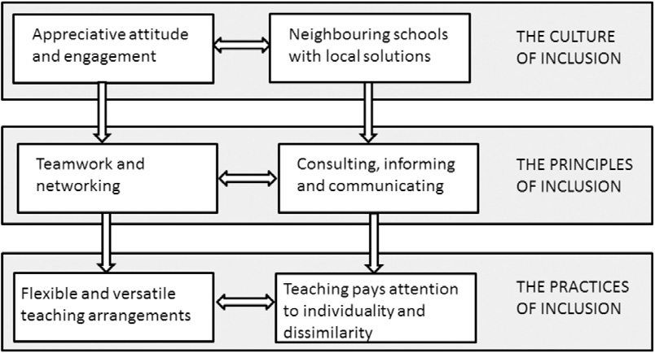
1. What kind of teachers do we need for an inclusive society in the 21st century school?
Inclusive school indexes (e.g., Booth & Ainscow 2002) experienced by Finnish teachers (designed by S. Lakkala, in 2013)
Notes:
To consider the first question addressed to this work shop I’ll introduce my latest research concerning the perceptions and experiences of inclusive arrangements of Finnish teachers. This review was made through the indexes of inclusion.
The culture of inclusion: First of all, teachers considered the co-operative and appreciative attitudes among the education personnel and other school staff and parents, crucial. Teachers pointed out that the starting point would always have to be students’ needs. In essence, the teachers stressed local, school-specific solutions.
The policies or principles of inclusion: The local schools are the neighborhood schools which produce flexible solutions in multi-professional collaboration. Teamwork was reported to consist of consultation, teacher cooperation, support given by assistants (or paraprofessionals), planning and teaching together with another teacher (s.c. co-teaching).
The teachers in this study reported that teamwork leads to good outcomes at many levels: pupils succeed in their studies and collaboration provides teachers with experiences of success, too.
In teachers’ opinions, inclusion will require in future new definitions of teachers’ roles; such as consulting, informing and communicating and more time in order to carry out all these tasks. Teachers acknowledge the importance of creating procedures or systems to flexibly modify support during the school year. These include, among others, support from different municipal and civic centers.
Moreover, the need for open and established routes of communication was expressed in teachers’ answers.
The practices of inclusion: teachers named flexible and diversified practices, and support for individuality and dissimilarity. The inclusive school naturally provides the outer environment for teaching: for example, classrooms should be easily adjustable for various purposes and for working with groups of different sizes. In addition, inclusive teaching makes it necessary to provide various teaching equipment and materials

Slide 3
2. Which are the essential teacher competences for inclusive education and diversity teaching?
Inclusion: same concept, different understandings
Contextual factors
The ways we understand inclusion has an impact on the interpretations we make from observing the needs of diverse students
They produce different kind of pedagogical knowledge and implementations in teaching and education (c.f. Booth & Ainscow 2006, Kesälahti & Väyrynen 2013)
Teacher competences: a reflective practitioner
Skills to reflect one’s teaching
Skills to combine theory and practice
Skills to collaborate and discuss
Notes:
INCLUSION CAN BE UNDERSTOOD IN MANY WAYS
Contextual factors such as geography, demography, culture, language, the structure of society and system of education INFLUENCE the ways we understand inclusion.
The ways we understand inclusion HAVE AN IMPACT on the interpretations we make from observing the needs of diverse students
They produce different kind of pedagogical knowledge and implementations in teaching and education
That’s why it seems that one of the basic elements of teachers’ profession or competences is the ability to act as A reflective practitioner WHICH INVOLVES FOLLOWING SKILLS:
Skills to reflect one’s teaching
Skills to combine theory and practice
Skills to collaborate and discuss

Slide 4
3. How can a common understanding of inclusion in teacher education and profession be achieved?
Through interpretive paradigm
During the 1980s qualitative research gradually became a more common and scholarly accepted way of knowing in educational research in Finland
In interpretive approaches the aim is to look for, describe and understand human action on the basis of individual (also collective) meaning making, to understand people’s inner world and the impact on their action
Teachers’ subjective experiences and meanings became appreciated→ teachers were given a voice in research
Lauriala Anneli, 2013
Faculty of Education
Notes:
The third question to consider is: How can a common understanding of inclusion in teacher education and profession be achieved?
One answer would be: through the interpretive paradigm.
During the 1980s qualitative research gradually became a more common and scholarly accepted way of knowing in educational research in Finland
In interpretive approaches the aim is to look for, describe and understand human action on the basis of individual (also collective) meaning making, to understand people’s inner world and ITS the impact on their action
Teachers’ subjective experiences and meanings became appreciated, TEACHERS WERE GIVEN A VOICE IN RESEARCH (TÄSSÄ VOISI VIIATTA SIIHEN MINUN ISATT-TEOKSEN ARTIKKELIIN JA MAHDOLLISESTI MYÖS SIINÄ KÄYTTÄMIINI LÄHTEISIINKIN)
SOME MORE INFO: Previously the role of research and theory in teacher education were viewed through the positivist paradigm
But teachers and students experienced the research findings, presented in statistical probabilities, trivial and far from the everyday life in classrooms
The positivist research divided the rich educational phenomena only to some features (i.e. variables) and left the teachers as outsiders of their own knowledge
As a consequence, teachers were viewed as technicians who only delivered the educational ends decided upon experts outside the school
In teacher education pedagogical actions were externally evaluated
Students became competitors as they had to prove their skills individually (KUTEN EDELLÄ)

Slide 5
Interpretive paradigm and teacher education
It came apparent that teachers’ consciousness; beliefs, conceptions and values guide their pedagogical actions
Interpretive research is context sensitive
This shift influenced in decision making in schools, too, in the form of creating local curricula (within national frames)
Teachers started to talk together about educational issues and to value discussions
This change has been slow but it has given Finnish teachers the competences to use and benefit from pedagogical autonomy given to them by school administration cf.Lauriala Anneli, 2013
Faculty of Education
Notes:
Interpretive paradigm and teacher education
It came apparent that teachers’ consciousness; beliefs, conceptions and values guide their actions in education
It became important to achieve intersubjectivity between researcher and teachers; Interpretive research is context sensitive
This shift influenced decision making in schools, too, in the form of creating, and school-based local curricula
Since 1980s the curriculum has only been given national frames (in 1985, 1994 and 2004) and since then the teachers were expected to plan the local application. Teachers started to talk together about educational issues and to value discussions.
This change has been slow but it has given Finnish teachers the competences to use and benefit from pedagogical autonomy given them by school administration

Slide 6
4. Can a competence or standards model facilitate an inclusive approach to teacher education?

Slide 7
Interpretive paradigm and teacher education in Lapland
Teachers are seen as active practitioners who reflect their own actions
The teacher education is based on the prospective teacher as a researcher -approach
The connection of theory and practice
Researching practice
Constructing personal, principled knowledge and strategies
Continuous development of professional identity is central
Lauriala Anneli, 2013
Faculty of Education
Notes:
Interpretive paradigm and teacher education in Lapland
The teacher education curriculum in Lapland is built around the idea of students as active constructors of their pedagogical knowledge and their personal teacher identities.
The teacher education is based on the prospective teacher as a researcher –approach. The entire teacher education program is understood as a reflective process. The focus varies from phase to phase.
There is a connection between the theory and practice: Each practicum is connected to a theoretical course at the university, and each practicum also involves learning about and practicing one research approach or method in authentic contexts.
BY Combining theory, practice and reflection students construct their personal knowledge and strategies. They develop their professional identity step by step. They built their DIGITAL pedagogical portfolio during their teacher education studies, which take approximately five years.

Slide 8
The roots of inclusive teaching and teacher education
The roots lie on understanding that the knowledge is created in practice by collegial discussions
That teacher knowledge, like education, is always situational and context bound
The pedagogical knowledge is jointly created in society and school communities; it is not value free but has caring and moral dimensions
Working/ teaching together makes it possible to create different kinds of learning environments
Diversity becomes natural and requires pedagogies based on differentiation and individualization
Faculty of Education

Slide 9
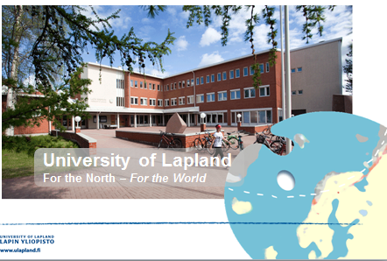
References
Lakkala, S., & Määttä, K. (2011) Toward A Theoretical Model Of Inclusive Teaching Strategies – An Action Research In An Inclusive Elementary Class. Global Journal Of Human Social Science Volume 11 Issue 8, pp. 30-40. http://socialscienceresearch.org/index.php/GJHSS/article/viewFile/216/179
Lakkala, S., Uusiautti, S. & Määttä, K. (2014) How to make the nearest school a school for all? Finnish teachers’ perceptions of educational reform aiming toward inclusion .Journal of research in special education needs. Early view online.
Lauriala Anneli, 2013. Changes in Research Paradigms and their Impact on Teachers and Teacher Education: A Finnish Case. In book: Craig, C. J., Meijer, P.C. & Broeckmans, J. (eds) From Teacher Thinking to Teachers and Teaching: The Evolution of a Research Community, vol. 19, Emerald (pp. 569 - 595).
Ainscow, M., Booth, T. & A. Dyson 2006. Improving Schools, Developing Inclusion. London: Routledge.
Kesälahti, E. & Väyrynen, S. 2013. Learning from Our Neighbours. Inclusive Education in the Making. Access: http://www.ulapland.fi/loader.aspx?id=a91a37cf-e63e-45f7-afe7-eebefd34a4d9
Faculty of education

