Slide 1
Workshop 4:
How to Recruit the Best?
20th January 2014

Slide 2
James Darley
Director of Graduate Recruitment
Teach First, UK

Slide 3
Session Objectives
Is there a magic wand solution to improve the image of teacher education and the teaching profession itself?
How can we improve candidate selection for teacher education programmes and entry conditions for new teachers?

Slide 4
In the UK, the link between low family income and poor educational attainment is greater than in almost any other developed country.

Slide 5
Over 50% of all males and 70% of all females in prison achieved no qualifications at
school or college
Labour Force Survey 2011
The odds against a child eligible for free school meals at a state secondary being admitted to Oxbridge are 2000:1……for a privately educated child it is 20:1
Sutton Trust 2010
Nearly 50% of children claiming free school meals achieve no GCSE passes above a D grade
Casen and Kingdon, 2007
Notes:
Some key stats to illustrate the problem:
A child growing up in a low-income community can become tied into a cycle of low educational achievement, inferior job opportunities and greatly increased chances of drug use, poor health and involvement with crime.

Slide 6
2009 GCSE Results by IDACI
Source: National Pupil Database and School Census information. 2009.

Slide 7
What is Teach First?
OUR VISION: that no child’s
educational success should be
limited by their socio-economic
background.
OUR MISSION: to end inequality in education by building a community
of exceptional leaders who create
change within classrooms, schools,
and across society.

Slide 8
Our impact
Independent Institute of Education Report 2013: Departments taking on Teach First participants were 10% of a GCSE grade worse before joining Teach First, but by years two and three they were outperforming their neighbouring departments who did not join Teach First (by about 15% of a GCSE grade).
"Our Teach First colleagues have been some of the most committed, enthusiastic, positive, caring and supportive staff it has ever been my privilege to work with." Marian Catterall, Principal, Manchester Creative and Media Academy
Part of Teach for All – 34 countries including Teach First Deutschland
Notes:
IoE report stats.
Quote from head.

Slide 9
Is there a magic wand solution to improve the image of teacher education and the teaching profession itself?

Slide 10
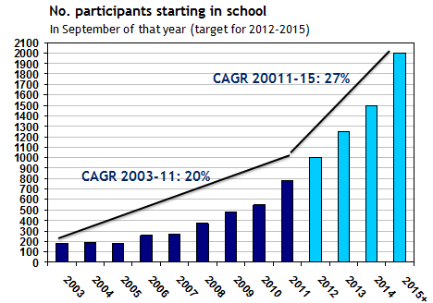
Achievements 2003 to 2013
Industry
Since 2003 nominated for 45 industry awards , winning 9 of these including over the past 2 years:
Best Employer Brand
Best Assessment and Selection
Most Popular Graduate Recruiter Public Sector (for third year running)
Rising Star for Jodie Bamforth (‘11)
In 2013 Teach First was responsible for 44% of ALL Public Sector jobs in the Times Top 100 Graduate Employers
In 2003: in 2013:
Oxbridge graduates going into challenging schools = 6 200
Teach First number of hires = 186 1,261
Times Top 100 Graduate Employers = n/a 3
% of new teachers in challenging secondary schools = 2% 16%
`
Notes:
10

Slide 11
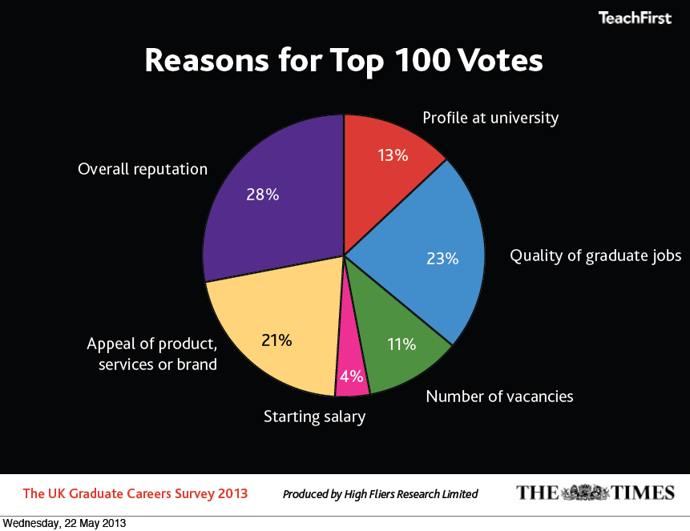

Slide 12
How did we do it?
Strategy
Sell the problem not the profession
Focus on small number of top universities at the start
Deliver ‘world-class’ graduate recruitment
Invest in building relationships with key stakeholders
Brand
Need to be comparable and then more attractive than the top employment brands in the country
Highest quality marketing, materials and activity
Position mutual benefit of the programme (do it for the kids/do it for you)
Build profile and appeal
Process
Human recruitment, investing in a team of experts (not superficial high visibility events)
Effective & efficient attraction & selection
Early ID & Undergraduate Programmes (Brand managers, Insight & Societies)
Research
Know your market and competition as well, if not better than everyone else
Deliver sophisticated objectives and metrics to spot issues early

Slide 13
How can we improve candidate selection for teacher education programmes and entry conditions for new teachers?

Slide 14
Selection Overview
Rigorous recruitment and selection process:
Evidence of strong academic qualifications
Demonstrate key competencies and fit with the Teach First vision:
Humility, Respect and Empathy
Interaction
Knowledge (incl. mission)
Leadership
Planning and Organising
Problem Solving
Resilience
Self-Evaluation
Pass professional skills tests in numeracy and literacy
Pass subject knowledge audit
School Observation week
Complete Summer Institute & PGCE in line with the Teach First values:
COMMITMENT COLLABORATION
EXCELLENCE INTEGRITY LEADERSHIP

Slide 15
Registration & Application
Candidate Journey
Submit
Screening
Fail
Pass
Assessment Centre
Fail
Pass
QTS
Skills
Test
Subject
Knowledge
Audit
Reference
Offer
Acceptance
Participant Preparation Work
Regional Allocation
Summer Institute

Slide 16
2014 Season
1,550 graduates to start the 2014 programme
(Inclusive of 435 deferred from last year)
600 graduate to start the 2015 programme
To meet this target we will need to:
Screen 8,680 applications twice
Invite around 4,400 candidates to an Assessment Centre (max capacity = 5,000)
Run 170 ACs
Make about 2,170 offers from AC
Give feedback to approx 1,800 candidates rejected from AC
Ensure our processes are consistent and professional
Communicate with candidates in a timely and professional manner building on the reputation created on campus

Slide 17
Selection Overview
Application Form:
Screened independently by two members of the team
Holistic approach taken:
Academics (ITT & Teach First)
Positions of Responsibility
Competency questions
Assessors trained and continually checked for consistency
Evidence/marking sheets used - decision made (no automatic cut off)
Conflict requires conversation to discuss evidence
Successful applications move on to Assessment Centre

Slide 18
London Assessment Centre Suite

Slide 19
Selection Overview
Assessment Centre:
Competency Based Interview:
Personal history, work experience, attitudes to working with children
Teach First competencies, motivation and ‘fit’ to Teach First vision and 2 year programme
Case Study:
School based group discussion (30 mins)
Case Study Self-Evaluation
Sample Teaching Lesson:
Candidates deliver pre-prepared 7 minute lesson on chosen National Curriculum subject
One week before AC candidates given topic titles
Sample Teaching Lesson Self-Evaluation
Offer & References

Slide 20
Selection Overview
Type of Analysis:
Competency benchmarking:
How is each competency scoring – historically and from diversity point of view
Consistency of assessors
Feedback from candidates:
Level of challenge, logistics, comfort and impression of charity
Efficiency/effectiveness of process & assessment centre capacity
Improvements:
Evolution of competencies based on pupil impact
Situational Judgment Test:
Candidates respond to situations they might encounter in school
Automated feedback reports

Slide 21
Any Questions?

Slide 22
Thank you

